Slide 1
Chapter 10 Light In the medical
Dr rafid albadr |

Slide 2
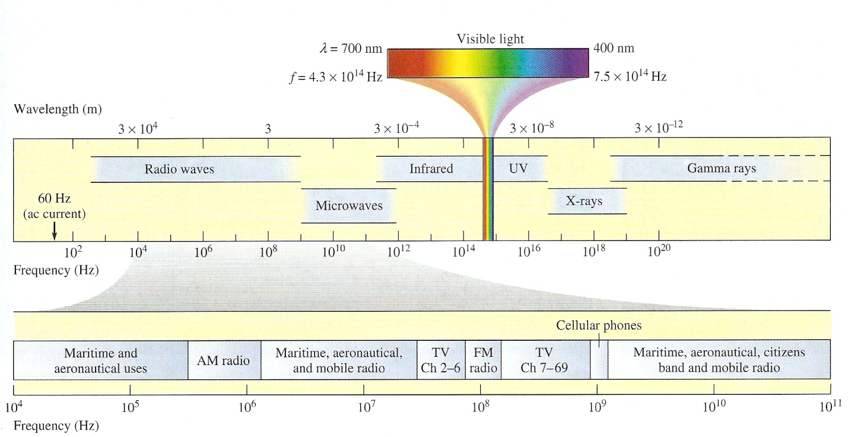
Light In the medical
Electromagnetic wave (EM) wave that consist of oscillating electric and magnetic fields.
EM wave in vacuum or in air travel at a speed of 3*10⁸ m/s.
The three basic dimensions of light (or better electromagnetic radiation) are:
• Intensity, which related to the human perception of brightness of the light;
• Frequency (or wavelength), perceived by humans as the color of the light, and
• Polarization (or angle of vibration), which is only weakly perceptible by humans under ordinary circumstances.

Slide 3
Light In the medical
Visible light : Visible light is the part of the spectrum that can be detected by the human eye.
wavelengths in vacuum of 700-400 nm. Light containing a mixture of all the wavelengths in the visible range appears white.
Infrared : (IR) is lower in frequency than visible light.
IR extends from the low-frequency (red) edge of the visible to a frequency of about The thermal radiation given off by objects near room temperature is primarily infrared,
with the peak of the radiated IR at a wavelength of about 0.01 mm = 10 µn.
At higher temperatures, the power radiated increases as the wavelength of peak radiation decreases.
Ultraviolet : (UV) radiation is higher in frequency than visible light.
UV ranges in wavelength from the shortest visible wavelength (about 380 nm) down to about 10 nm.

Slide 4
Speed of light in matter
The speed of EM in vacuum is represented by the symbol c and equal 3*10⁸ m/s.
when an EM wave travel through a material medium it travels at speed υ that is less for example visible light travels through glass at speeds between about 1.6*10⁸ m/s and 2*10⁸ m/s, depending on the type of glass and the frequency of the light.
The ratio of the speed of light in a vacuum to its speed in a given material called the index of refraction n
$$n=\frac{C}{v}$$

Slide 5
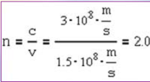
Speed of light in matter
Example:
The velocity of Red light (λ=0.6µm) in a certain medium is 1.5*10⁸m/s. What is the wavelength of this light in this material?
Solution:
First find the index of refraction:
Using n, calculate the wavelength in the material:

Slide 6
Energy of a photon
The energy of a photon is related to its frequency, a wavelike property, by
$$E=hf$$
Where h is Planck's constant ( = 6,623*10⁻³⁴ Js),
Because $f=C/λ$, we can also write Equation
$$E=hf=hC/λ$$
energy and momentum of a photon are related as E= pc.
$$P=E/C=h/λ$$
Ultraviolet photons have energies greater than visible photons, while IR photons have lower energies. Because of their higher energies, UV photons are more useful than IR photons

Slide 7
Energy of a photon
Example : Calculate the number of photons per second in a 1 W beam from an argon ion laser with a wavelength of 514.5 nm.
Solution: Since each green photon carries an energy given by Equation
$$E=\frac{hC}{λ}=6.6×{10}^{−34}×3×\frac{{10}^{8}}{514.5}×{10}^{−9}=3.8×{10}^{−19}J$$
The number of photon in 1W beam is given by
$$N=\frac{1 J}{3.8×{10}^{−19}}=2.6×{10}^{18} photons/s$$

Slide 8
Refraction
When light passes through a transparent substance, such as air, water or glass, its speed is reduced,
When a beam of light enters a medium from vacuum or another medium, it keeps the same frequency.
The reflection of light that the equations predict is known as Fresnel reflection and Snell’s law describes the refraction.
When light moves from a medium of a given refractive index n₁ into a second medium with refractive index n2, both reflection and refraction of the light may occur.
The fraction of the intensity of incident light that is reflected from the interface is given by the reflection coefficient R, and the fraction refracted by the transmission coefficient T. The Fresnel equations assume that the two media are both non-magnetic.

Slide 9
Refraction
When the light is about perpendicular to the interface (θp ≈ θ ≈ 0), R and T are given by:
$$R=\frac{n_{1}−n_{2}}{n_{1}+n_{2}}$$
and $T=1−R$

